Slide 1


Data Science for Data Security
Anish Mahapatra | 26 May, 2022

Slide 2

Agenda
01
Introduction
02
What is Data Science?
03
Components of Data Security
04
Case Study: Machine Learning for Data Security
05
How Machine Learning plays a part?
06
Tools & Technologies
Notes:
Expertrons Company Profile: Valuation & Investors | PitchBook

Slide 3











Topic 1 of 6
Introduction
Lead Data Scientist
LinkedIn: www.linkedin.com/in/anishmahapatra Medium: anishmahapatra.medium.com Website: www.anishmahapatra.com
GitHub: www.github.com/anishmahapatra
Q. How to get into Data Science?
A. Simple, ask a real-world Data Scientist. PGD (DS), MSc in Data Science (Distinction)

Slide 4
Topic 2 of 6
What is Data Science for Data Security?
“Data Science preemptively stamps out cyber threats and bolsters security infrastructure through pattern detection, real-time cyber crime mapping and thorough penetration testing”

Slide 5
Topic 2 of 6
What is Data Science?
01
02
03
Data Access
Data Silos to Data Warehouse
Data Analytics & Modelling
Identify List of Data Owners,
Request Access,
Maintain Single POC,
Understand current process
Exploratory Data Analysis,
Business Analytics,
Heuristic, Statistical & ML Models.
Experimentation
Make Data Dictionary,
Set up Data pipelines, Make ER Diagram, Main Analytical Data frame
06
05
04
Business Decisions, Impact Analysis
Data Visualization & Dashboarding
Feature Engineering
Building new features, Combining external data, Building a feature store
Model Evaluation, Monitoring Model Performance and Drift, Data Governance Policies
Dashboards to aid decision-making,
Decide concurrency, cadence and security

Slide 6
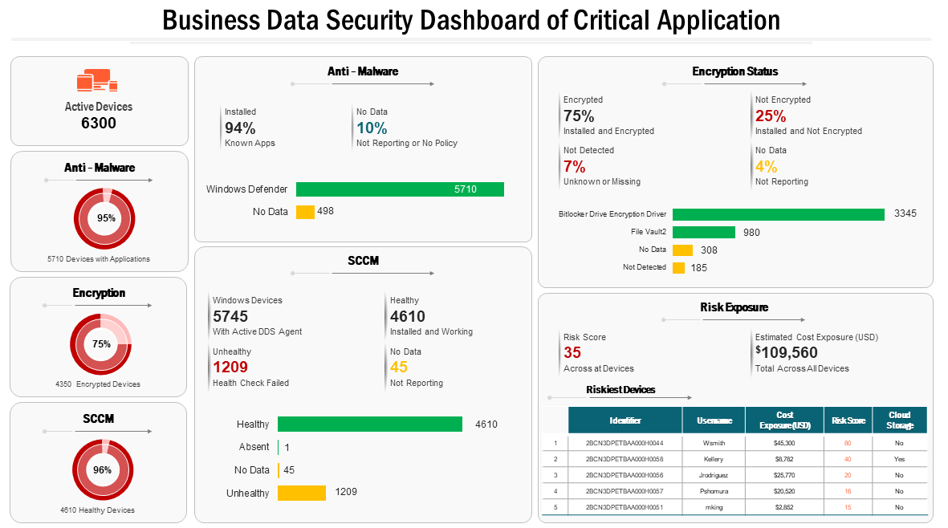
Topic 2 of 6
Security Dashboard

Slide 7





Topic 3 of 6
Components of Data Security
01
02
03
Confidentiality
Integrity
Availability
Privacy to the sensitive information while it is in transit over a network
Refers to preventing data from being tampered with, modified, or altered in an unauthorized way to achieve malicious goals
Security service which ensures the constant availability of resources and services to only authorized parties in a timely manner.
CIA Triad
04
05
Authenticity
Accountability
Refers to the state of being genuine, verifiable or trustable.
Refers to the ability to trace back the actions to the entity that is responsible for them
Notes:
Source:https://www.payscale.com/research/IN/Job=Data_Scientist/Salary

Slide 8
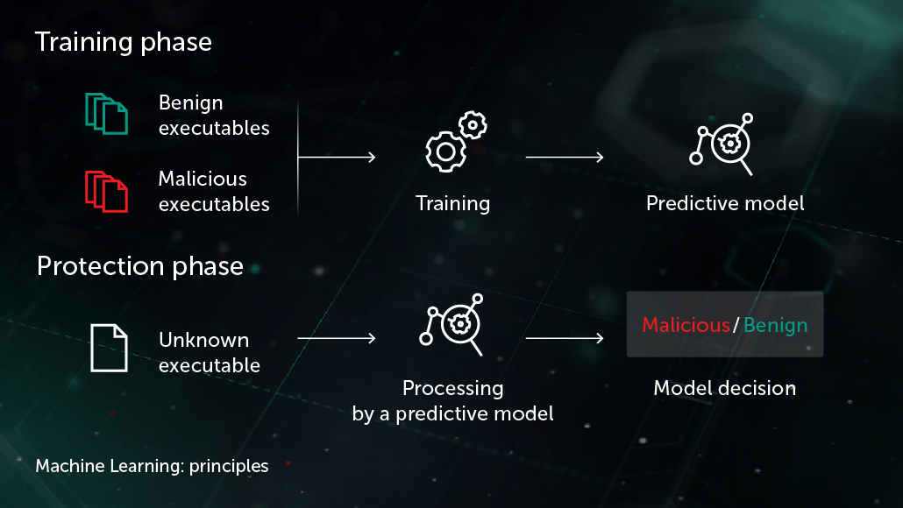
Topic 4 of 6
Case Study: ML for Data Security - I
Notes:
Source: https://www.cisco.com/c/en/us/products/security/machine-learning-security.html#~how-ml-helps-security

Slide 9
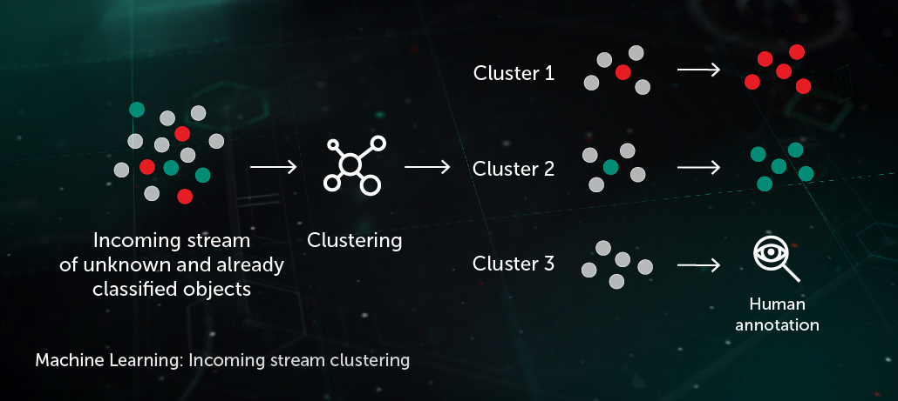
Topic 4 of 6
Case Study: ML for Data Security - I
Notes:
Source: https://www.cisco.com/c/en/us/products/security/machine-learning-security.html#~how-ml-helps-security

Slide 10
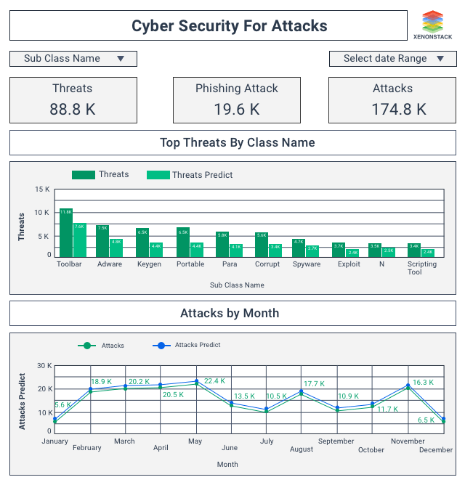
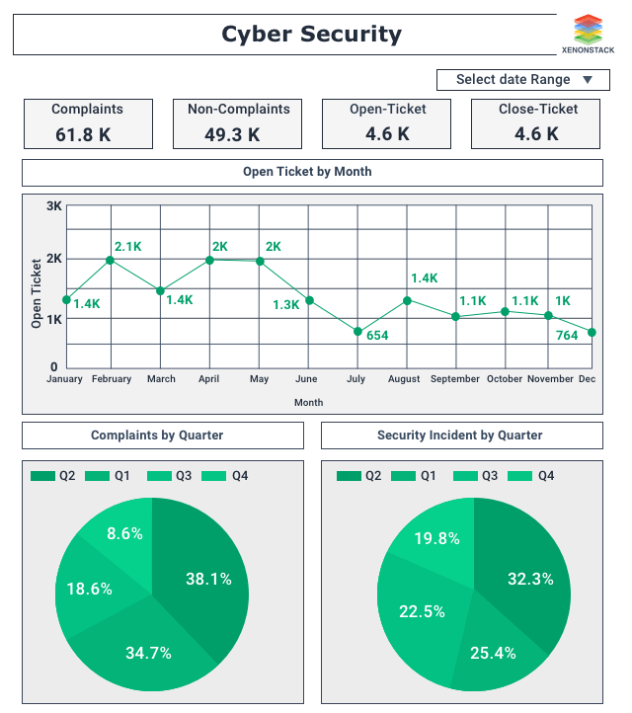


Topic 4 of 6
Case Study: ML for Data Security - II
Notes:
Source: https://www.cisco.com/c/en/us/products/security/machine-learning-security.html#~how-ml-helps-security

Slide 11






Topic 3 of 6
How does Machine Learning play a part?
Network Threats
Detect Malware in
encrypted traffic
Monitor Network for Anomalies, ML allows us to identify detection of insider threats, unknown malware, policy violations
3D Printing helps increase supply chain flexibility, helping eliminate the need for expensive tools and fixtures
Protect Data in the Cloud
Safe Browsing
ML can predict “bad neighborhoods” by analyzing internet activity. It identifies attack infrastructures
Analyze encrypted traffic data elements in common network telemetry. Malicious patterns can be identified without decrypting
Endpoint Malware protection
Algorithms can detect never-before-seen malware attacks that is trying to run on the endpoints

Slide 12









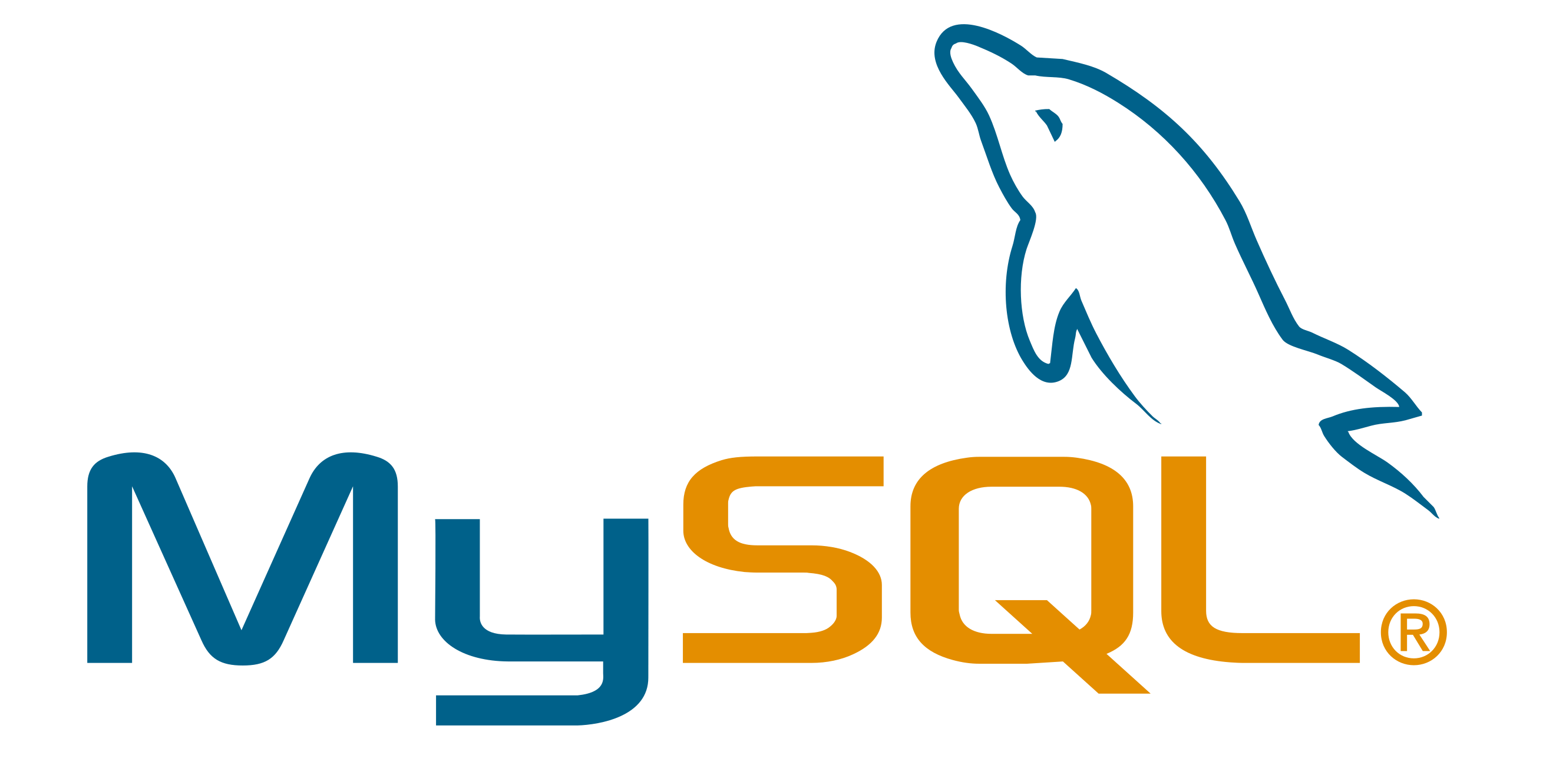










Topic 5 of 6
Tools & Technologies in Data Science
Data Platforms
Languages / Development Tools
Data Exploration / Visualization
ML / AI Tools

Slide 13
Key Takeaways
01
What is Data Science?
02
Components of Data Security
03
Case Study: Machine Learning for Data Security
04
How Machine Learning plays a part?
05
Tools & Technologies
Notes:
Expertrons Company Profile: Valuation & Investors | PitchBook

Slide 14

Data Science for Data Security
Anish Mahapatra
Q&A Session
Q. How to get into Data Science?
A. Simple, ask a real-world Data Scientist.
Email: anishmahapatra01@gmail.com
LinkedIn: www.linkedin.com/in/anishmahapatra
Email: anishmahapatra01@gmail.com

Slide 15

Data Science for
Data Security
Anish Mahapatra | 26 May, 2022
Q. How to get into Data Science?
A. Simple, ask a real-world Data Scientist.
Email: anishmahapatra01@gmail.com
Q. How to get into Data Science?
A. Simple, ask a real-world Data Scientist.
Email: anishmahapatra01@gmail.com
Thank you.

